Slide 1
Demand Estimation

Slide 2
Demand Estimation
Demand estimation in managerial economics refers to predicting how consumers will behave in relation to your products and services in the future.
The estimation is often based on a number of different variables that can include changes in price, changes in how your competition increases or decreases its prices, and economic factors such as a recession, which would affect consumer buying.
As a result, you may decide that you can raise prices because demand will remain steady or even increase, or you may decide that you will have to pull back on production because circumstances are not likely to be favorable.
Demand estimation in managerial economics is an important way for you to determine the short-term and long-term course of your business.

Slide 3
Methods of Demand Estimation
Several methods of demand estimation in managerial economics.
It helps to obtain a clear picture of what might happen to customer demand level in the future.
One of the popular steps in demand estimation is to conduct a survey, which often includes focus groups and direct interviews with customers.
Surveys are useful because you are obtaining information from your target market and they can tell you their fears, hopes, and future plans.
However, there are some drawbacks with this method because customers may tell you what they will do in the future and circumstances could quickly change those purchasing plans. It's also difficult to get a truly representative sample when you conduct surveys.

Slide 4
Regression Analysis
Another of the common steps in demand estimation is regression analysis in which a dependent variable such as demand for a product or service is compared to an independent variable such as price.
Regression analysis is concerned with the study of the dependence of one variable, the dependent variable, on one or more other variables, the explanatory variable with the view to estimating and/or predicting the (population)mean or average values of the former in terms of the known or fixed (in repeated sampling) values of the latter.

Slide 5
Use of Regression Analysis
To study For example,
An economist may be interested in studying the dependence of personal consumption expenditure on after tax or disposable real personal income.
A monopolist who can fix the price or output may want to find out the response of the demand for a product to changes in price.
A labour economist may want to study the rate of change of money wages in relation to unemployment rate.
From monetary economics it is known that other things remaining the same, the higher the rate of inflation the lower the proportion of their income that people would want to hold in the form of money.

Slide 6
Use of Regression Analysis
The marketing director of a company want to know how the demand for company’s product is related to say advertising expenditure. That is to say percent change in demand in response to 1 percent change in the advertising budget.
Finally an agronomist may be interested in studying the dependence of crop yield say of wheat on temperature, rainfall, amount of sunshine and fertiliser. Such a dependence analysis may enable the prediction or the forecasting of the average crop yield, given information about the explanatory variable.

Slide 7
Advertising Expenditure and Sales Revenue

Slide 8
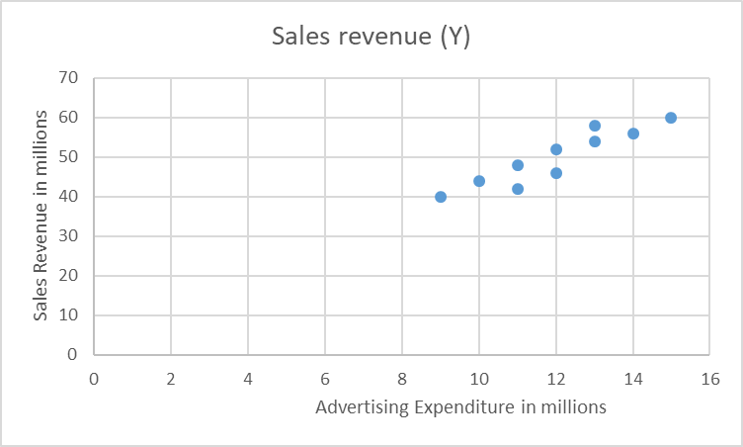

Slide 9
The Ordinary Least Squares Method

